Slide 1

SOA PROJECT REVIEW – 1
AI-Enhanced Expense Tracking System
A Spring Boot microservices platform that helps users record, categorize and understand their expenses — with AI-assisted suggestions and insights.
TEAM MEMBERS
UNDER THE GUIDANCE OF
2420030634 Srivathsava Reddy
2420030140 R Sai Charan
Dr.Neelima Gogineni
Professor, Dept. of CSE
KLH Bowrampet Campus
September 2026

Slide 2




Problem Statement
Manual expense tracking is slow, error-prone, and gives people little insight into where their money actually goes.
Time-consuming to manage
Records get lost or forgotten
Little automation today
Our proposed fix
Recording daily expenses manually takes real time and effort from users.
Users often forget to log expenses or lose track of where records are kept.
Existing tools mostly store and display expenses, with limited automation or personalization.
A simple system to record, view, and budget expenses — with AI to suggest categories and surface basic insights.
AI-Enhanced Expense Tracking System — SOA Review 1
3

Slide 3




Objectives
What the system is designed to deliver for the end user
Record, update & delete
Simple categorization
Spending visibility
Full control to record, update, and delete daily expenses.
Organize expenses into clear, simple categories.
View monthly and category-wise spending at a glance.
5
Budget monitoring
AI-assisted insights
core objectives guiding scope, design, and the Review-1 demo
Set and monitor a monthly budget in real time.
Use AI to suggest expense categories and surface simple spending insights.
AI-Enhanced Expense Tracking System — SOA Review 1
4

Slide 4
Problem Gap Identification
CURRENT LIMITATION
OUR RESPONSE
Manual categorization is slow and error-prone
→
AI-powered automatic categorization
Basic tracking only stores and displays expenses
→
AI-based spending analysis
No personalized suggestions for the user
→
Personalized suggestions based on history
Manual entry requires significant user effort
→
Simple, user-friendly expense entry
Limited analysis makes patterns hard to see
→
AI-based spending insights
Traditional reports lack meaningful insight
→
Interactive reports and dashboards
Gap statement: Current systems mainly store and display expenses; this project adds AI categorization, personalized suggestions, and simple spending insights.
AI-Enhanced Expense Tracking System — SOA Review 1
6

Slide 5


Innovation, Creativity & Novelty
Simple & user-friendly
A straightforward expense tracking experience with minimal friction.
AI category suggestions
AI suggests categories directly from expense descriptions.
History-aware insights
Basic spending insights generated from the user's own history.
Budget monitoring
Monthly budget monitoring keeps spending on track.
AI-Enhanced Expense Tracking System — SOA Review 1
7

Slide 6
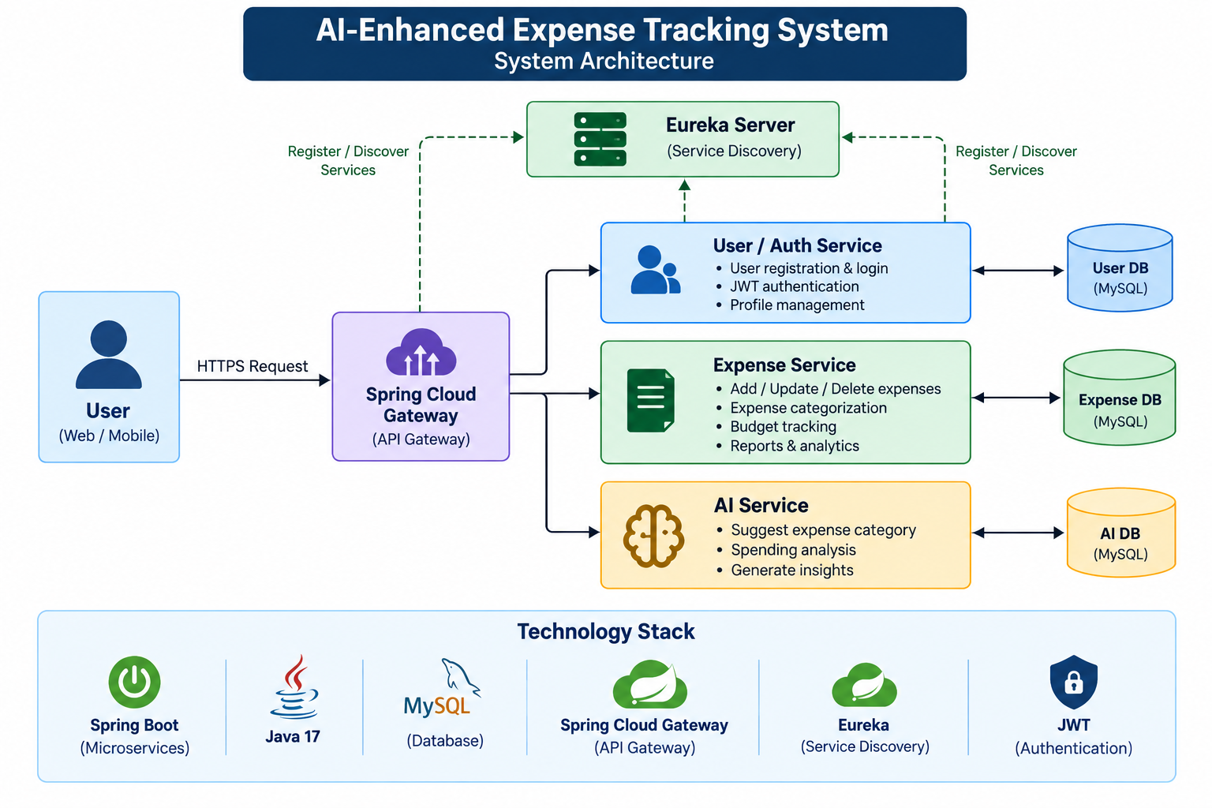
Project Architecture / Overview

Slide 7
Methodology
Requirements Analysis & System Design — Gather functional requirements (record/update/delete expenses, budgeting,
AI categorization), define service boundaries for the SOA architecture, and design the MySQL schema and UI wireframes.
Microservices Development — Build the core Spring Boot services independently: the User/Authentication service
(JWT-based login) and the Expense service (CRUD operations, category-wise and monthly summaries), each backed by its own
database, registered with Eureka, and routed through Spring Cloud Gateway.
AI Integration — Implement the AI Service that takes an expense description, calls an LLM API (e.g., Gemini)
to suggest a category, and computes basic spending insights (top category, month-over-month trend, budget alerts)
from the user's own transaction history.
Testing & Security — Validate each service's REST APIs using Postman, run static analysis with Semgrep, enforce
JWT-based authentication and role checks, and perform end-to-end integration testing across all services via the gateway.
Integration, Deployment & Evaluation — Wire all services together behind the gateway, set up CI/CD with
GitHub Actions, deploy the integrated system, and evaluate it against the stated objectives
(accuracy of category suggestions, usability of budget tracking, and correctness of spending insights)
during the final demo/review.

Slide 8





Project Plan
FIVE-Module DELIVERY PLAN
Module 1
Module 2
User & authentication service
Expense service & database
Module 5
Integration, CI/CD & final demo
Module 3
Module 4
AI feature & reports
Testing & security
AI-Enhanced Expense Tracking System — SOA Review 1
9

Slide 9
